Slide 1
INTRODUCTION TO TIME SERIES ANALYSIS

Slide 2
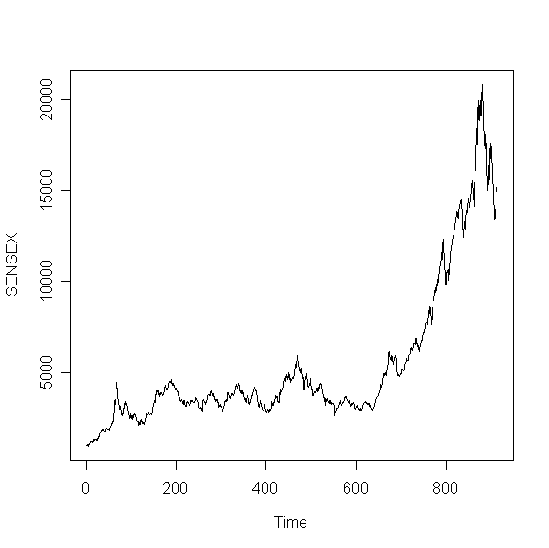
What is Time Series?
Time Series is a sequence of values measured over time.
Time series can be
Annual- ( GDP, Company Turnover)
Quarterly-(GDP, Company Turnover)
Monthly-( Inflation Rates)
Daily-(Stock prices, Gold Prices)

Slide 3
Components of Time Series? Trend, Seasonality and Cyclic Pattern
Trend refers to the long-term increase or decrease in the time series.
Seasonality in a time series refers to predictable and recurring trends and patterns over a period of time, normally a year. An example of a seasonal time series is retail data, which sees spikes in sales during holiday seasons like Christmas or Diwali.
A cyclic pattern exists when data exhibits rises and falls that are not of fixed period. The duration of these fluctuations is usually of at least 2 years.

Slide 4
Time Series Data Analysis
Analyze trend and seasonality present in the data.
Decompose time series into its components.
Forecast future values of the time series.

Slide 5
Stationary Time Series
Time series process is called stationary if the statistical properties of the process remain unchanged over time.
i.e if Y_{t} is a time series t=1,2,3,… then
E(Y_{t})= μ_{t} = μ (constant) ∀ t=1,2,…
Var(Y_{t})= σ_{t}² = σ² (constant) ∀ t=1,2…
Cov(Y_{t},Y_{t-s}) depends only on s(lag),
and is independent of t (time).

Slide 6
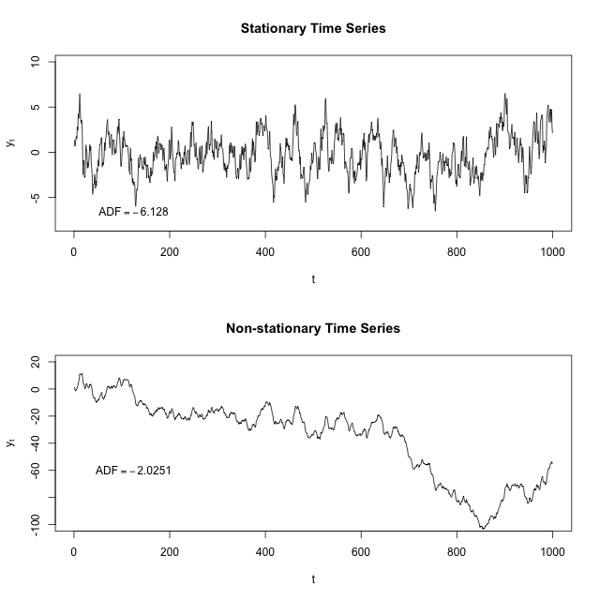
Stationary Time Series
Examples: Stock returns can be stationary although stock prices are non-stationary
Macroeconomic data such as GDP, Inflation Rates are also non stationary.

Slide 7
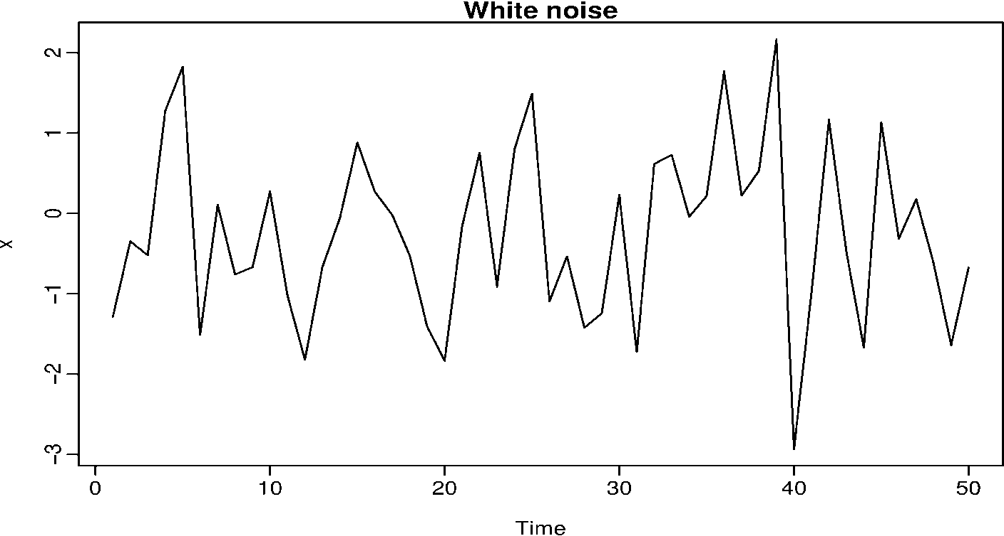
White Noise Process
White noise is the simplest example of stationary time series.
White Noise time series has zero mean, constant variance and zero covariance with lagged time series.

Slide 8
Random Walk Non-Stationary Time Series
Random walk is the simplest case of non-stationary time series. It is of the form
Y_{t}=Y_{t-1}+U_{t} t=1,2,3….. (1)
We assume that U_{t} is a random series with constant mean μ and constant variance σ^{2.} Also it is serially uncorrelated .
From 1 it is clear that value of Y at time t is equal to its value at time (t-1) plus a random shock.
Let Y₀=0 at time t=0 , hence
Y₁= U₁
Y₂= Y₁+ U₂ = U₁+ U₂
Y₃= Y₂+ U₃ = U₁+ U₂+ U₃
so, Y_{t} =Σ U_{t} t=1,2,3…..

Slide 9
Why Random Walk is Non-Stationary?
Y_{t} =Σ U_{t}
E(Y_{t} )= E(Σ U_{t}) =t.μ
i.e Mean is not constant
Y_{t} =Σ U_{t}
var(Y_{t} )= E(Σ U_{t}) =t. σ²
Variance is not constant
Conclusion:
Random Walk is a non stationary time series.

Slide 10
Importance of Stationary Time Series
Calibration (Estimation of model parameters using historical data.) is an important concept in the forecasting of time series values.
In the calibration of time series models we need a stationary time series.
With a non stationary time series we get into spurious regression, which badly affects forecasting.

Slide 11
How to Make a Non Stationary Time Series Stationary?
There are 2 methods to make a non stationary time series stationary.
Differencing
De-trending
Differencing: A non stationary time series can be made stationary by differencing. Consider the following non- stationary process
Y_{t}=Y_{t-1}+U_{t} t=1,2,3…..
We assume that U_{t} is a random series with constant mean μ and constant variance σ² also it is serially uncorrelated i.e (U_{t} is stationary).
Hence Y_{t}-Y_{t-1}=ΔY_{t} = U_{t} , which is a stationary time series.
Differencing can be well applied in case of stochastic time series.

Slide 12
How to Make a Non Stationary Time Series Stationary? (Contd.)
Detrending:
Consider the following regression:
Y_{t} = β₁ + β₂t +U_{t}
where U_{t} is stationary with, say mean zero and variance σ².
When trend element (β₁ + β₂t) is subtracted from the above equation, the result is a stationary process.
De-trending is useful when trend is deterministic.
Forecasts made from a Trend-Stationary Process will be more reliable in the long-run.

Slide 13
Identifying Stationary Time Series
Methods
Graphical
Analytical
Correlogram
D-F test

Slide 14
Concept of Autocorrelation
A mathematical representation of the degree of similarity between a given time series and a lagged version of itself over successive time intervals.
Autocorrelation is a correlation between a time series (Y_{t} ) and another time series representing lagged values of the same time series.(Y_{t-k})
Autocorrelation is a correlation coefficient. However, instead of correlation between two different variables, the correlation is between two values of the same variable at times Y_{t} and Y_{t-k}

Slide 15
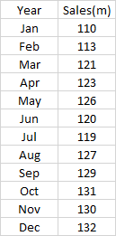
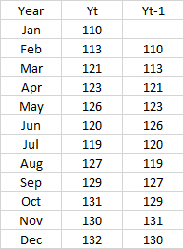


Autocorrelation of Lag 1
$$r_{1}=0.588$$

Slide 16
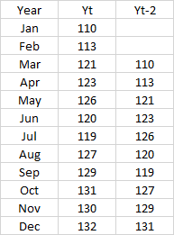

Autocorrelation of Lag 2
$$r_{2}=0.204$$

Slide 17

Correlogram
Plot of the sample Autocorrelation function against lag
is called correlogram.
ACF (autocorrelation function) is a general expression for lag k autocorrelation.
Correlogram is mainly used in deciding stationarity of a series.
r_{K} = Sample autocorrelation of lag K

Slide 18
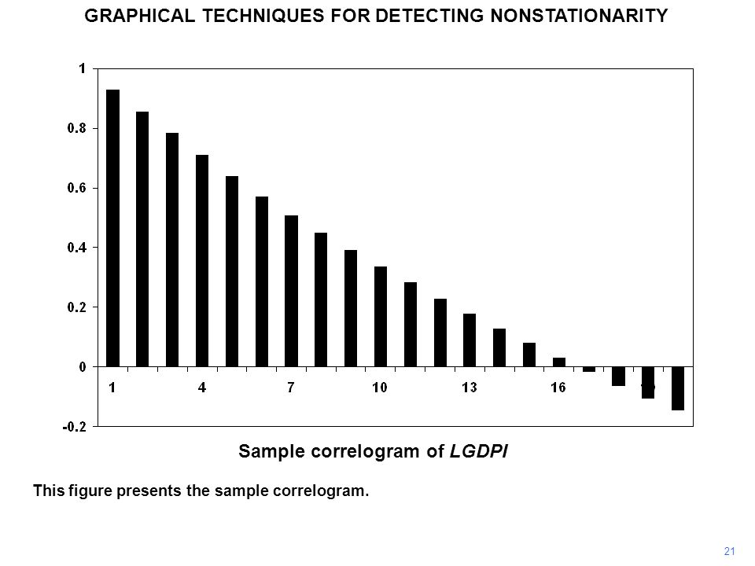
Correlogram for Checking Stationarity
For a non-stationary time series showing trend, slow decay pattern will be observed.
If a time series is characterized by seasonal fluctuations, then the correlogram would also exhibit oscillations at the same frequency

Slide 19
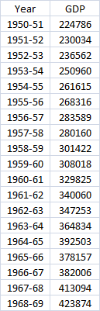
GDP Time Series Data Snapshot
This is partial data.
The data has GDP values
for 1950-51 to 2006-07

Slide 20
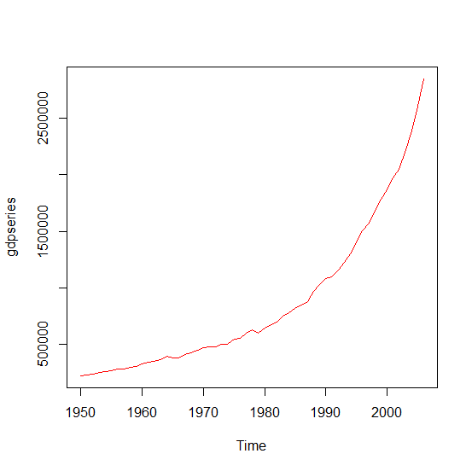
Time Series Analysis in R
Plot Time Series
gdpdata<-read.csv(file.choose(),header=T)
# Define time series using ts function
gdpseries<-ts(gdpdata$GDP,start=1950,end=2006)
plot(gdpseries,col="red")
Clearly a non-stationary time series.

Slide 21
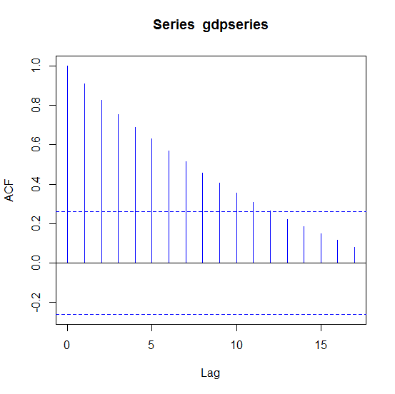
Time Series Analysis in R
Correlogram
acf(gdpseries,col="blue")
Very slow decay.
Sign of non-stationarity

Slide 22
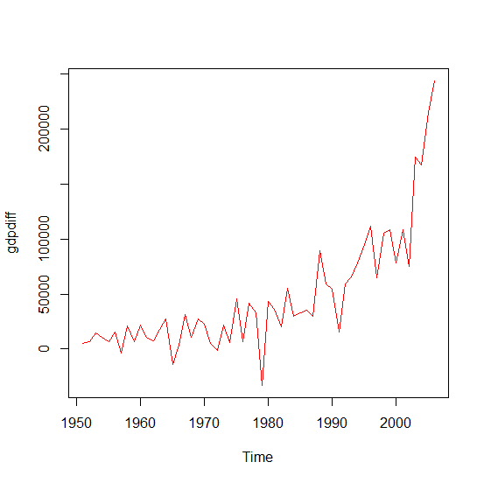
Time Series Analysis in R
Plot Difference Time Series
gdpdiff<-diff(gdpseries,differences=1)
plot(gdpdiff)
First difference also looks
non-stationary time series.

Slide 23
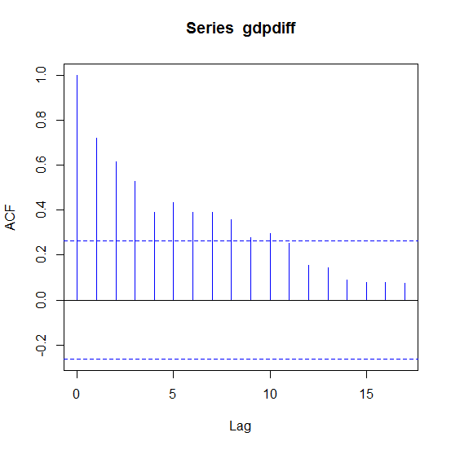
Time Series Analysis in R
Correlogram for Difference Time Series
acf(gdpdiff,col="blue")
Slow decay.
Sign of non-stationarity

Slide 24
Time Series Analysis in R
Correlograms
 | Comp.1 | Comp.2 | Comp.3 | Comp.4 | Comp.5 | Comp.6 | Comp.7 | Comp.8
Standard deviation | 2.5741 | 0.9355 | 0.3982 | 0.3522 | 0.2829 | 0.2603 | 0.2148 | 0.1499
Proportion of Variance | 0.8282 | 0.1094 | 0.0198 | 0.0155 | 0.0100 | 0.0085 | 0.0058 | 0.0028
Cumulative Proportion | 0.8282 | 0.9376 | 0.9574 | 0.9729 | 0.9830 | 0.9914 | 0.9972 | 1.0000
Stationarity is not achieved with first difference

Slide 25
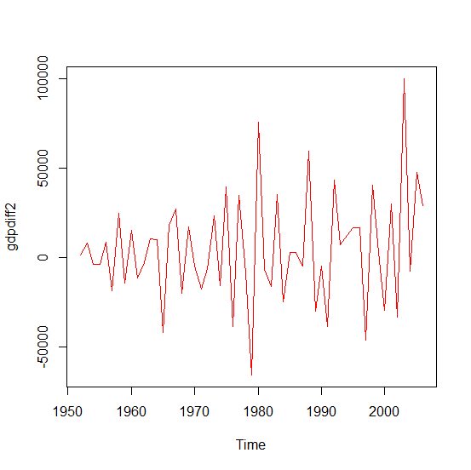
How Many Times Should Time Series Be Differenced to make Stationary?
install.packages("forecast")
library(forecast)
ndiffs(gdpseries) # gives 2
gdpdiff2<-diff(gdpseries,differences=2)
plot(gdpdiff2,col="red")

Slide 26
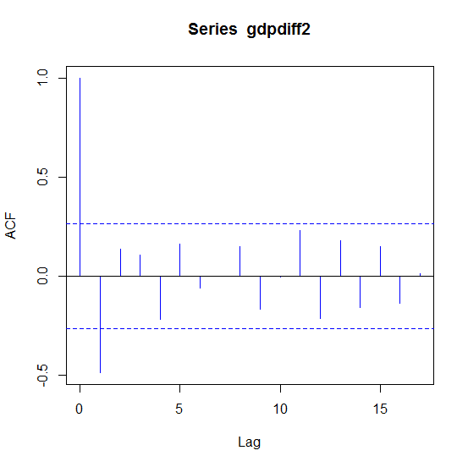
Time Series Analysis in R
Correlogram for Difference2 Time Series
acf(gdpdiff2,col="blue")
 | Comp.1 | Comp.2 | Comp.3 | Comp.4 | Comp.5 | Comp.6 | Comp.7 | Comp.8
Standard deviation | 2.5741 | 0.9355 | 0.3982 | 0.3522 | 0.2829 | 0.2603 | 0.2148 | 0.1499
Proportion of Variance | 0.8282 | 0.1094 | 0.0198 | 0.0155 | 0.0100 | 0.0085 | 0.0058 | 0.0028
Cumulative Proportion | 0.8282 | 0.9376 | 0.9574 | 0.9729 | 0.9830 | 0.9914 | 0.9972 | 1.0000

Slide 27
Time Series Analysis in R
Correlograms
 | Comp.1 | Comp.2 | Comp.3 | Comp.4 | Comp.5 | Comp.6 | Comp.7 | Comp.8
Standard deviation | 2.5741 | 0.9355 | 0.3982 | 0.3522 | 0.2829 | 0.2603 | 0.2148 | 0.1499
Proportion of Variance | 0.8282 | 0.1094 | 0.0198 | 0.0155 | 0.0100 | 0.0085 | 0.0058 | 0.0028
Cumulative Proportion | 0.8282 | 0.9376 | 0.9574 | 0.9729 | 0.9830 | 0.9914 | 0.9972 | 1.0000
Stationarity is achieved with second order difference

Slide 28
Dickey Fuller (DF) test
Consider X_{t} (t=1,2,3,…) is a time series of the form
X_{t}=ρX_{t-1}+U_{t}. ………………(1)
If ρ=1 then X_{t} becomes a random walk.
We assume that U_{t}~IID(0, σ² ), i.e U_{t} is a white noise.
So we are interested in testing for ρ=1.

Slide 29
D-F (Unit Root) Test
H₀: ρ=1 (Non stationary) , H₁: ρ<1(stationary)
(X_{t}-X_{t-1}) =ΔX_{t}=(ρ-1)X_{t-1}+U_{t}…………..from(1)
H₀: ρ*=0 , H₁: ρ*<0, ρ*=(ρ-1).
Test statistic is (ρ*/SE(ρ*)).
Test statistic follows DF distribution under null.
Reject H₀ if tcal < DF table value.

Slide 30
Time Series Analysis in R
Dickey Fuller Test
library(urca)
df<-ur.df(gdpseries,lag=0)
summary(df)
Value of test-statistic is: 19.2745
Critical values for test statistics:
1pct 5pct 10pct
tau1 -2.6 -1.95 -1.61
Inference: Time series is non-stationary. Value of test statistic is greater than
5% critical value.

Slide 31
Time Series Analysis in R
Dickey Fuller Test
library(urca)
df<-ur.df(gdpdiff2,lag=0)
summary(df)
Value of test-statistic is: -11.9083
Critical values for test statistics:
1pct 5pct 10pct
tau1 -2.6 -1.95 -1.61
Inference: Time series is stationary. Value of test statistic is less than
5% critical value.

Slide 32
THANK YOU!!

